Slide 1

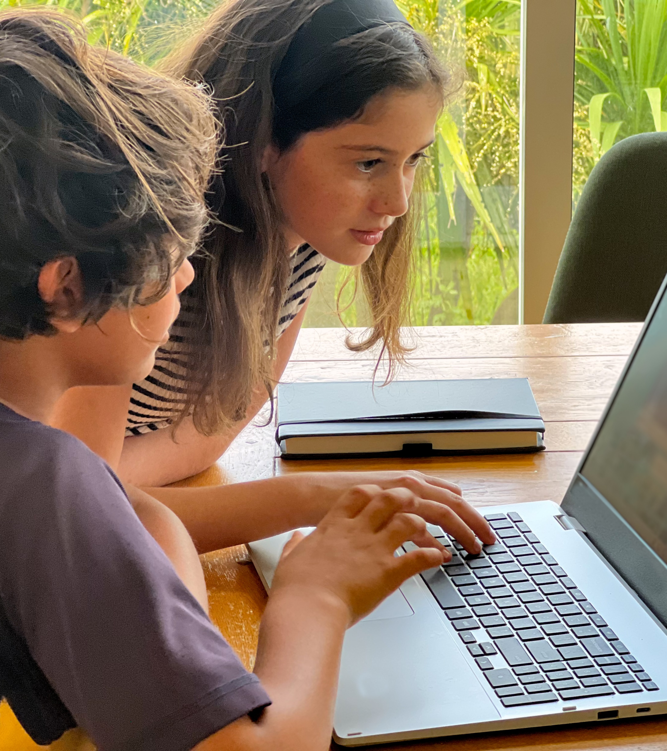



Where Are The Audiences - Children’s Media Use 2025
REPORT
November 2025

Slide 2
Contents
01
Summary
02
Devices available at home
03
Media consumption
04
Watching shows on traditional linear and streaming platforms
05
Preschooler content preferences
06
Social media and audio
07
Online games
08
What influences children’s content choices?
09
YouTube in detail
10
Engaging with New Zealand and te reo Māori content
2

Slide 3

Background
NZ On Air, this year in partnership with Te Māngai Pāho, is undertaking the third wave of its children’s media research to deepen understanding of how children (aged 2 to14)* in Aotearoa New Zealand engage with media.
Building on previous studies conducted in 2014 and 2020, this 2025 wave adapts the proven Where Are The Audiences (WATA) ‘deep dive’ methodology – combining qualitative and quantitative approaches – to explore evolving behaviours, preferences, and cultural connections in children’s media consumption.
This research responds to the growing challenge of reaching young audiences who have shifted away from traditional local platforms, often missing out on culturally resonant content. It also aligns with NZ On Air’s statutory commitment to reflect and develop New Zealand identity and culture, including the promotion of te reo Māori and stories – an objective shared by Te Māngai Pāho, which plays a vital role in supporting te reo Māori content across media platforms.
* Note that the qualitative research provides insights for caregivers and their children aged 2 to 14 years. The quantitative research in this report provides data and insights for caregivers and their children aged 4 to 14 years (similar to previous Children’s Media Use research).
3

Slide 4
What types of media are children and young people in New Zealand consuming?
When, where, how, and why are they accessing the content they engage with?
What levels of parental comfort and control exist around children’s media use?
Key research questions
How do children experience cultural connection through locally produced content?
What barriers exist to accessing or engaging with New Zealand made content?
How do children access YouTube, and what controls or restrictions do caregivers use to manage this access?

Slide 5





What we did
Target audience
Survey dates
Survey length
Sampling and size
Weighting
Children aged 4 to 14 years and their caregivers or parents
Fieldwork took place 5th to 28th September
The online survey took approximately 25 minutes to complete, comprising 15 minutes for caregivers and 10 minutes for children.
A total of 1,024 caregivers and their children were recruited via the Consumer Link online panel and a short telephone recruitment survey. All participants, including those recruited by phone, completed the survey online. A sample size of 1,024 has a maximum margin of error +/- 2.18%
Weighting was applied to ensure the final sample profile was representative of the 4 to 14 year old population by age, gender, region, ethnicity, and household income. Additionally, weighting by day of the week was used to ensure responses to 'yesterday' questions were representative across the full week.
Verian

Slide 6

01
Summary

Slide 7
Summary
01 | 02 | 03 | 04 | 05
New Zealand platforms remain trusted homes for local content | Children’s autonomy accelerates with age | Visibility is vital for local content to thrive | New Zealand and te reo Māori content deserve the spotlight | Cultural connection matters
While YouTube is a key content destination, caregivers and children still expect to find New Zealand and te reo Māori content on free to air and OnDemand platforms. Leverage the trust and familiarity of New Zealand broadcast and on demand platforms by making local content highly visible, easy to access, and clearly labelled so families can confidently find and enjoy New Zealand stories where they already go for trusted local content. | Caregivers of children aged 4 to 8 are much more likely to set restrictions and controls on what their child watches. By ages 9 to 14, many caregivers say their child mostly chooses their own content, including platforms like YouTube. Prioritise 4 to 8 year olds and their caregivers. Think carefully about how to reach the older 9 to14 year olds. Many are finding their own content on YouTube making it algorithm driven. Understanding how this works is key. | Children’s daily media habits are shaped by digital platforms like YouTube, social media, and playing online games. And … Children and caregivers prize New Zealand and Māori content for its cultural connection, learning, identity benefits – and being seen as safe content. Yet, even with these benefits, local content often gets lost on digital platforms. Increasing visibility, clear labelling, and discoverability (through algorithms) will help more families recognise, access, and enjoy the great content already being produced. | A major barrier isn’t just finding New Zealand and Māori content – it’s the perception that it’s less appealing or lower quality than overseas options. To close this perception gap and help families discover what’s truly on offer… Showcase the quality and appeal of modern local productions directly to caregivers through: - targeted recommendations - curated “best of” lists - visible endorsements from trusted sources | Both Māori and non-Māori families value te reo Māori content, but for different reasons. 78% of caregivers who engage with te reo Māori content say it’s important for their child. Many non-Māori caregivers want their child to connect with Māori culture – often preferring te reo Māori to be ‘sprinkled’ in familiar shows. Children say Māori content helps them learn, feel connected, and be proud of who they are. Continue to offer a spectrum of content, from fully immersive to te reo Māori woven throughout to meet diverse needs and support language revitalisation.

Slide 8
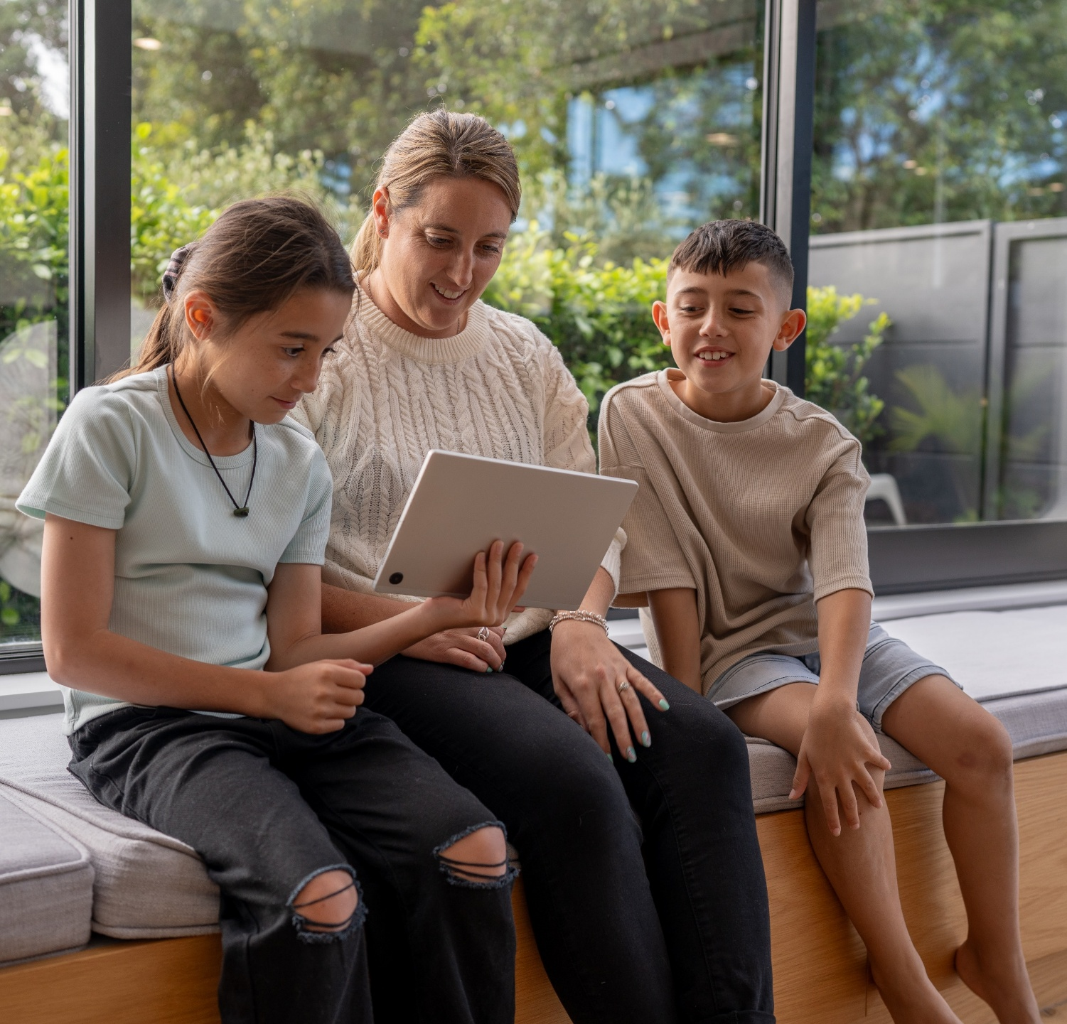

02
Devices available at home

Slide 9
Devices available at home – summary
Devices available at home
New Zealand households with children (4 to14) are highly equipped with smart technology: 95% have smartphones, 94% televisions, and 82% smart TVs.
Computers/laptops (83%), tablets (71%), gaming consoles (63%), and streaming devices (56%) are also common, reflecting a strong shift toward interactive and on-demand media.
In contrast, ownership of traditional devices – radios (40%), DVD/Blu-ray players (32%), SKY TV boxes (20%), and PVRs (16%) – continues to decline, highlighting the move away from legacy formats and the growing dominance of digital platforms.
Socio-demographic insights
Smart tech ownership is high across all income groups, but lower income households are less likely to have computers, streaming devices, and smart speakers.
Traditional device ownership remains low and consistent regardless of income.
Device availability is broadly similar across ethnic groups and regions, with Māori and Pacific households showing comparable levels of smartphone and television ownership to NZ European and Asian households. Regional differences are minimal, though Auckland and higher income households tend to have slightly higher rates of smart device ownership.

Slide 10
Smart tech is everywhere, streaming climbs, traditional devices dip.
Streaming device ownership rose from 43% to 56%, while radio, DVD players, SKY boxes, and PVRs declined. Most TVs are now smart enabled, with household access at 82% compared to 54% in 2020.
            Devices available in your home
82%
Smart TV
2020
93% | 94% Smart TV 54% | 89% | 70% | 61% | 43% | 55% | * | 46% | 32% | 24%
            Source: Q11. Which of these devices do you have in your home?
            Base: All caregivers of children aged 4-14 years 2025 (n=1,024); All caregivers of children aged 6-14 years 2020 (n=1,112).
            Note: * Not asked in 2020
            Significantly higher than 2020
            Significantly lower than 2020

Slide 11








Smartphones and TVs are nearly universal, but device ownership varies by income and ethnicity.
Low income households are less likely to own Smart TVs, computers, and streaming devices, while high income households lead in Smart TVs, tablets, and smart speakers. Pacific households are less likely to own a Smart TV but more likely to have SKY TV boxes.
Smartphone (95%) & Television (94%)
– high across all demographics
Device Ownership – lower ownership
Device Ownership – higher ownership
Region
Smart TV (82%)
Low income households (up to $50k) 62%
Pacific households (73%)
High income households ($150k+) more likely to own:
Computer / laptop (83%)
Low income households 70%
Smart TV (89% v 82% total) | Tablet/iPad (78% v 71% total) | Smart speaker (43% v 34% total)
Streaming devices e.g. Apple TV, Chromecast (56%)
Low income households 46%
Pacific households:
More likely to have SKY TV box (28% v 20% total).
Smart speakers (34%)
Low income households 22%
Pacific households 27%
DVD or Blu-ray player (32%) and SKY TV box (20%)
Asian households 23% and 12% respectively
Other South Island:
More likely to own a radio (54% v 40% total)
            Source: Q11. Which of these devices do you have in your home?
            Base: All caregivers of children aged 4-14-years-old (n=1,024).
            Significantly higher than Total
            Significantly lower than Total

Slide 12

03
Media consumption

Slide 13
Media consumption – summary
Daily reach
New Zealand children’s media habits are increasingly shaped by digital platforms, with YouTube (69%) leading daily engagement.
On a typical day, around seven in ten children watch programmes or shows on linear / on demand TV, or YouTube. Two in five play online games or listen to audio content, and a quarter use social media.
Time spent using
Media consumption is spread across multiple devices and platforms, with children spending over an hour daily on overseas streaming services, YouTube, social media, playing online games, and music streaming.
Traditional TV and SKY peak during prime time (6 to 8:30pm), but digital platforms see strong engagement after school and into the evening.
Girls engage with both streaming and YouTube, while boys gravitate toward YouTube, SKY TV, and online games.
Socio-demographic insights
Socio-demographic factors play a role: older children and those from higher income households spend more time on digital platforms, while Māori children show higher participation in online games.
Overall however, regional and ethnic differences in media consumption are minimal, ensuring broad access to content across the country.

Slide 14





On a typical day, around seven in ten children watch shows and programmes, or YouTube. Two in five play games online or listen to audio content, and a quarter use social media.
            Type of media children consume each day
54%
27%
70%
Watch programmes or shows
69%
Watch YouTube or YouTube Kids
39%
Play games online
38%
Listen to radio, audiobooks or music streaming services
24%
Use social media
            Source: Q14. Thinking about yesterday, which of the following activities did [CHILD] do for 5 minutes or more?
            Base: All caregivers of children aged 4-14-years-old (n=1,024).

Slide 15
Older children are more likely to play online games than younger children.
            Types of media children consume each day
Watch programmes or shows (NET)
Watch YouTube or YouTube Kids (NET)
Play games online
            Source: Q14. Thinking about yesterday, which of the following activities did [CHILD] do for 5 minutes or more?
            Base: All caregivers of children aged 4-14-years-old (n=1,024).

Slide 16
Older children are more likely to listen to audio content or use social media than younger children.
            Types of media children consume each day
Listen to radio, audiobooks or music streaming services
Use social media
            Source: Q14. Thinking about yesterday, which of the following activities did [CHILD] do for 5 minutes or more?
            Base: All caregivers of children aged 4-14-years-old (n=1,024).

Slide 17
When we break these broad categories down, we see the most popular activities are engaging with YouTube, watching shows on overseas services such as Netflix, and playing online games.
            Types of media children consume each day
2020
44%
35%
*
*
*
51%
*
*
*
27%
14%
8%
5%
*
Programmes or shows
YouTube
Online games
Audio
Social media
Watch TV on an overseas service
Watch live or on demand (BVOD) free to air TV
Watch live or recorded TV through Sky or MySky
Watch live or recorded TV through Freeview
Watch a TV show on Neon
YouTube
YouTube Kids
Played online games
Listened to music online
Listened to a NZ radio station-broadcast/online
Listened to music including CDs or iPod
Listened to a podcast or audiobook
Listened to an overseas radio station online
Watched a video on social media
            Source: Q14. Thinking about yesterday, which of the following activities did [CHILD] do for 5 minutes or more?
            Base: All caregivers of children aged 4-14-years-old (n=1,024).
            Notes: * Comparison to 2020 data not available – code either not asked in 2020 or altered in 2025. This means for these codes, we cannot make meaningful comparisons to 2020 data.
            Significantly higher than 2020
            Significantly lower than 2020

Slide 18


Girls balance streaming and YouTube use, while boys gravitate towards YouTube, Sky TV, and online games.
Girls engage equally with overseas streaming services (50%) and YouTube (49%), whereas boys show a stronger preference for YouTube (60%), online games (46%), and Sky TV (15%)
            Types of media children consume daily
            Media differences by gender
Ethnicity
Boys Girls
YouTube (54%)
YouTube Kids (27%)
4 to 8’s (39%)
9 to 11’s (63%)
12 to 14’s (70%)
4 to 8’s (42%)
9 to 11’s (21%)
12 to 14’s (9%)
Play online games (39%)
Listen to music online (26%)
Watch TV on an overseas service | Watch live or recorded TV through Sky or MySky | YouTube | Played online games | Listened to music online | Listened to a NZ radio station-broadcast/online
4 to 8’s (20%)
9 to 11’s (52%)
12 to 14’s (55%)
12 to 14’s (36%)
4 to 8’s (22%)
            Source: Q14. Thinking about yesterday, which of the following activities did [CHILD] do for 5 minutes or more?
            Base: All caregivers of children aged 4-14-years-old (n=1,024).
            .
            Significantly higher than Total
            Significantly lower than Total

Slide 19
When children consume media
Children consume media across platforms at distinct times of day. Traditional TV (live or OnDemand) and SKY peak during prime time (6pm – 8:30pm), competing with overseas services (e.g. Netflix), YouTube/YouTube Kids and social media. However, Netflix, digital platforms (especially YouTube) see strong engagement earlier, notably after school.
Watch TV on an overseas service
Watch live free-to-air TV
Watch BVOD
46%
21%
19%
Watch TV through Sky or MySky
Net YouTube/YouTube Kids
Social media
11%
69%
24%
Source: Q15. When did [CHILD] do this activity yesterday?
Base: All parents and caregivers who’s child did each activity yesterday (n=113 to n=571)
XX%
Proportion who watch this type of content each day

Slide 20
When children consume audio and play online games
Audio consumption varies by format. New Zealand radio peaks during school commutes, while streaming music, podcasts, and audiobooks are mostly enjoyed after school and into the evening. Playing online games peaks earlier, with strong engagement from after school through to evening.
Listen to music online / streaming service
Listen to New Zealand radio station broadcast or online
26%
13%
Play online games
Listen to a podcast or audiobook
39%
5%
Source: Q15. When did [CHILD] do this activity yesterday?
Base: All parents and caregivers who’s child did each activity yesterday (n=50 to n=394).
XX%
Proportion who watch this type of content each day

Slide 21
            Multiple media compete for children’s attention every day.
            Children spend more than an hour daily on overseas streaming services, YouTube, social media, online games, and music platforms – highlighting a crowded media landscape.
            Average time children spend on different activities
Watch TV on an overseas service | Watch live free-to-air TV | Watch NZ BVOD on demand TV | Watch live/ recorded TV through Sky/ MySky | Watch live or recorded TV through Freeview
YouTube / YouTube Kids | YouTube | YouTube Kids | Social media | Online games
Listening to music online | Listening to a NZ radio station-broadcast/online | Listening to a podcast or audiobook | to music including CDs or iPod | Listening to an overseas radio station online
Verian
Source: Q16. Still thinking about yesterday, approximately how long did [CHILD] spend on each of the following activities?
Base: All parents and caregivers who’s child did each activity yesterday. (n=50 to n=571)

Slide 22
            Children’s media time splits between broad reach and deep engagement, with traditional platforms still contributing to the mix.
            YouTube leads in reach and strong engagement, while online games, social media, and streaming services like Netflix attract smaller audiences but hold attention for over an hour daily.
            New Zealand free to air and BVOD offer a complementary mix of media platforms that work well together to help children access content.
            Time spent by the proportion engaging in each activity
Verian
Source: Q14. Thinking about yesterday, which of the following activities did [CHILD] do for 5 minutes or more? Q16. Still thinking about yesterday, approximately how long did [CHILD] spend on each of the following activities?
Base: All parents and caregivers who’s child did each activity yesterday. (n=50 to n=571)

Slide 23
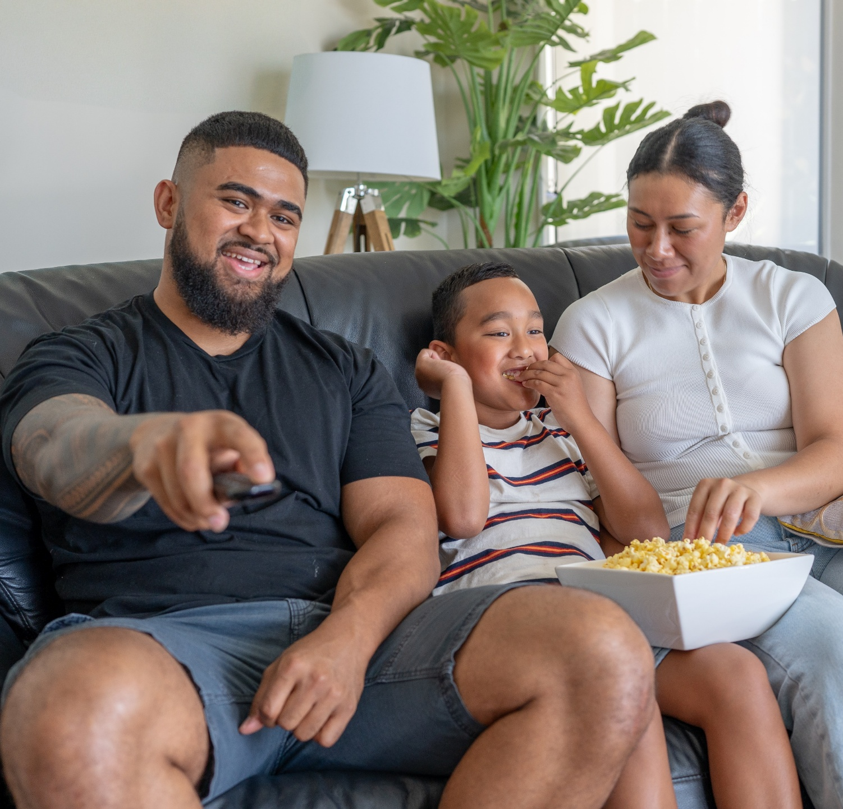
04
Watching shows on traditional linear and streaming platforms

Slide 24
Programmes and shows – summary
Platform
YouTube remains the dominant platform for children’s viewing, reaching 69% of the audience daily and maintaining its lead over other services.
Streaming platforms, led by Netflix (36%), are also highly popular, though Netflix’s reach has declined from 47% in 2020.
Traditional TV viewing continues to decrease, with live free-to-air TV now at 14% daily reach and on demand free-to-air services holding steady at 12%.
SKY TV channels reach 9% of children each day.
Socio-demographic insights
Viewing preferences vary by age, ethnicity, and household income.
Netflix appeals broadly but peaks among Māori children (40%), those aged 9 to11 (41%), and high income households ($150k+ at 41%).
TVNZ channels show particular strength among Pacific children and younger age groups, with TVNZ1 and TVNZ2 reaching 14% and 10% of Pacific children, respectively.
Implications
These findings highlight the ongoing shift toward digital viewing, with local broadcast platforms still playing an important role for specific groups.
The data underscores the need for local content to be highly visible and easily accessible on both traditional and digital platforms to ensure New Zealand children can discover and enjoy stories that reflect their culture and identity.

Slide 25
YouTube and Netflix still lead children’s viewing, but streaming gains are mixed and traditional viewing shows some declines.
            Daily reach of platforms, channels and streaming services for watching programmes and shows
Streaming Services (net 45%)
2020 result
2020 result
Sky TV channels (net 9%)
47%
12%
1%
2%
3%
-
6%
7%
1%
-
2%
1%
4%
2%
1%
YouTube reaches 69% of children daily, maintaining its lead, while Netflix remains the top streaming service at 36% – down from 47% in 2020. Live free to air viewing has declined, while BVOD services hold steady as part of the daily media mix.
YouTube (net 69%)
51%
-
NET daily reach of linear and on demand
Live free-to-air (net 14%)
TVNZ / TVNZ+
SKY*
16%
15%
12%
2%
20%
9%
On demand free-to-air TV (net 12%)
9%
1%
5%
Three / ThreeNow 4%
Whakaata Māori / Māori+ 3%
*SKY channels, SKY Open, SKYGo
Verian
Source: Q71. What did you watch yesterday?
Base: All children 5 to 14 years n=1,024 Note: YouTube data is based on Q13, caregivers of children aged 4 to 14 years, n=1,024
            Significantly higher than 2020
            Significantly lower than 2020

Slide 26





Netflix appeals broadly but peaks among Māori and high income households, while TVNZ shows strength with Pacific children and children of mixed ages.
Netflix reaches 36% of children overall, with higher reach among Māori, high income households, and children 9 to 11 years while TVNZ 1, TVNZ 2, and TVNZ+ perform better among Pacific children and a range of age groups including 12 to 14’s and 5 year olds.
Daily Reach
9 to 11 years (41%)
Māori (40%)
Household income $150k+ (41%)
12 to 14 years (14%)
Pacific children (14%)
Household income $50 - $100k (13%)
Pacific children (10%)
5 year olds (10%)
13 year olds (12%)
Higher Daily Reach
5 year olds (13%)
12 to 14 years (14%)
Asian children (32%)
Boys (33%)
Household income $50 - $100k (29%)
Pacific children (12%)
Household income $50 - $100k (13%)
Lower Daily Reach
5 to 8 years (7%)
9 year olds (2%)
Asian children (4%)
Source: Q71. What did you watch yesterday?
Base: All children 5 to 14 years n=1,024
WATA Children’s Media Use 2025

Slide 27
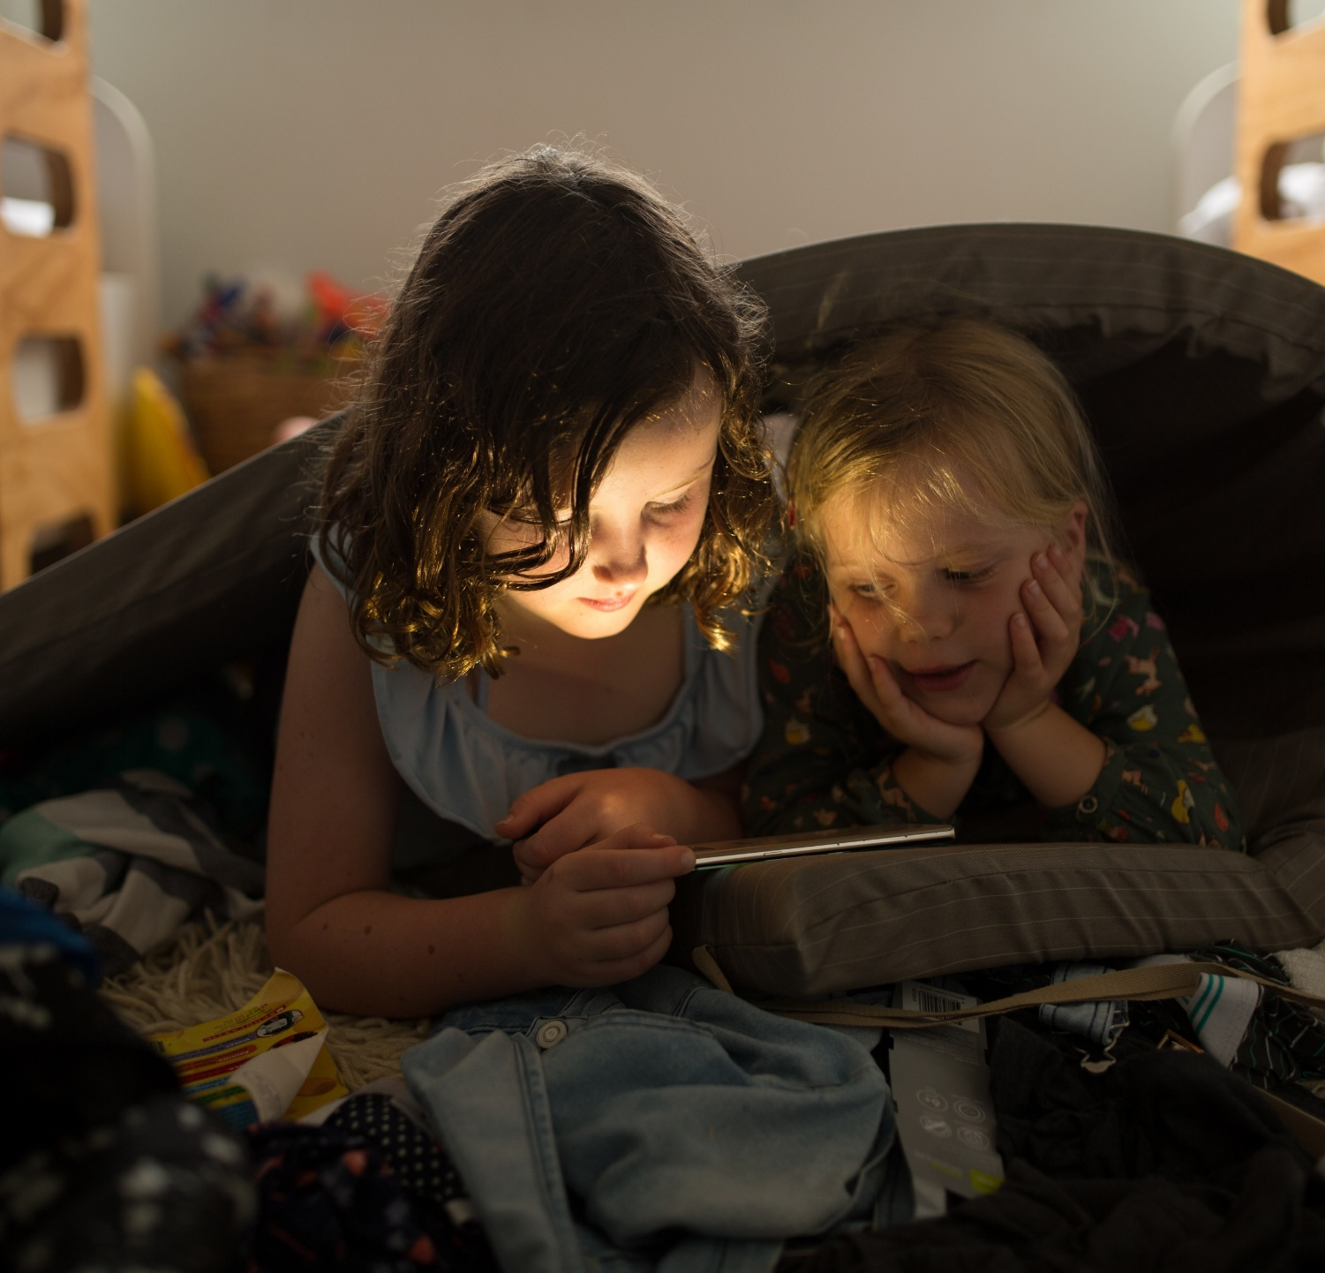
05
Preschooler content preferences

Slide 28
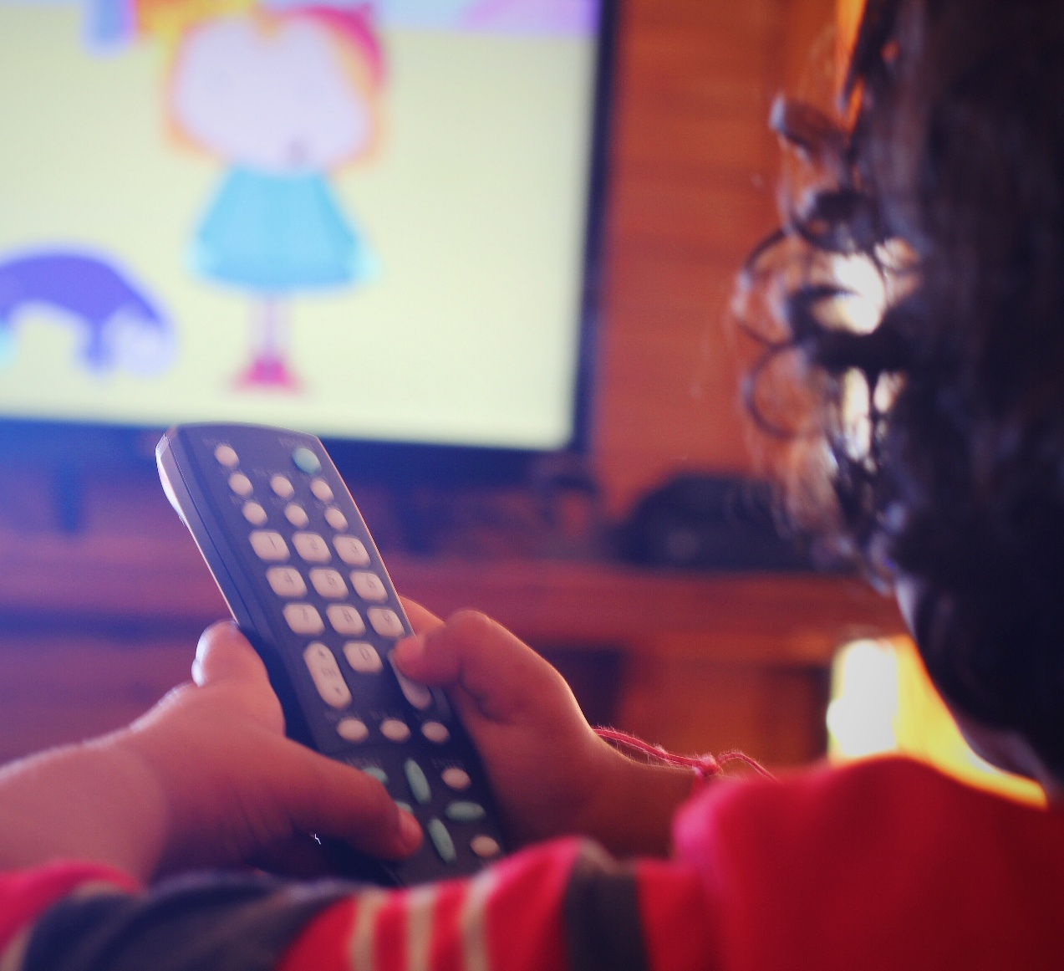
Preschooler content preferences – summary
Caregiver satisfaction and preschooler viewing preferences
Most caregivers (60%) are satisfied with the range of New Zealand content available for preschoolers (4 years), though nearly a third remain neutral or unsure.
Despite this satisfaction, global brands overwhelmingly dominate preschoolers’ favourite shows, with Bluey (38%), Paw Patrol (25%), and Spidey and Friends (16%) leading the list.
New Zealand made shows such as Kiri & Lou and Nee Naw are named by 6% of caregivers, and 75% cannot name a preferred local title.
These findings highlight the challenge for New Zealand content to stand out against international offerings and underscore the need to further promote and showcase high quality New Zealand productions, ensuring local stories are both visible and appealing to caregivers and young audiences.

Slide 29
            Most caregivers (60%) are satisfied with New Zealand content for preschoolers, but a third (32%) are unsure or neutral.
            Caregiver satisfaction with the range of New Zealand content available for pre-schoolers on free to air channels
Very satisfied
Quite satisfied
Neutral
Quite dissatisfied
Not sure
Very dissatisfied 0%
Verian
            Source: Q65. How satisfied or dissatisfied are you with the range of New Zealand content that is currently available for pre-school children on free to air TV channels such as TVNZ 2, Three, Whakaata Māori or Sky Open?
            Base: Caregiver of child aged 4 years old n=32. CAUTION: Low base size, results indicative only.
WATA Children’s Media Use 2025

Slide 30
            Bluey leads as preschoolers’ favourite show, followed by Paw Patrol and Spidey.
            38% of caregivers say their preschooler’s top pick is Bluey, followed by Paw Patrol (25%) and Spiderman / Spidey and Friends (16%).
            Preschoolers’ favourite shows
Includes shows ≤ 3%: E.G. Bob the Builder, Chip & Milo, Walking with Dinosaurs, Teen Titans, Super Kittens, Star Wars, Baby Bus
            Source: Q61. What is the one show that [CHILD] enjoys watching most?
            Base: Caregiver of child aged 4 years old n=32. CAUTION: Low base size, results indicative only.
Verian
WATA Children’s Media Use 2025

Slide 31
            Caregivers name few New Zealand shows as preschooler favourites. Global titles still dominate.
            6% of caregivers named Kiri & Lou or Nee Naw as favourites, while most couldn’t name a preferred New Zealand made show – highlighting the challenge of standing out against global content.
            Preschoolers’ favourite New Zealand made shows
            Source: Q63. Is there a favourite New Zealand made show/s [CHILD] enjoys that you haven’t already mentioned?
            Base: Caregiver of child aged 4 years old n=32. CAUTION: Low base size, results indicative only.
Verian
WATA Children’s Media Use 2025

Slide 32
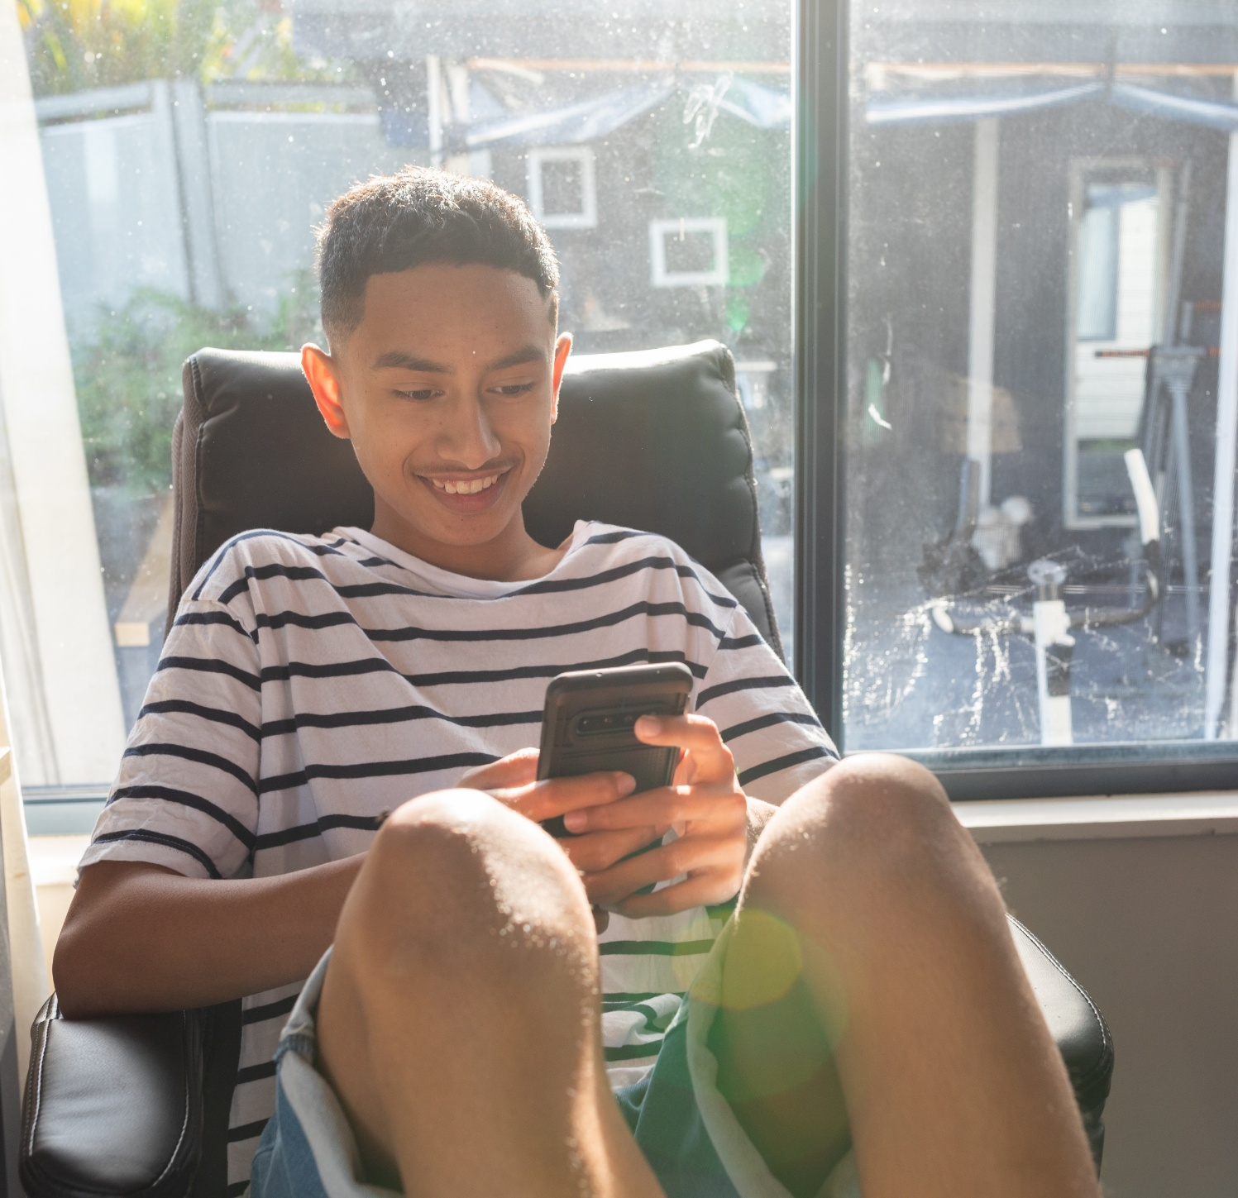
06
Social media and audio

Slide 33
Social media and audio – summary
Platforms
Social media and audio platforms are integral to children’s daily media habits, with 24% using social media and 38% engaging with music or audio content each day.
Spotify has emerged as the preferred audio platform for children, with daily reach rising to 25%, overtaking YouTube for music (9%).
Usage of social media platforms like TikTok and Snapchat lead social media use, while audio streaming continues to grow, especially among older children (12 to14 years), who show the highest engagement across most platforms.
Socio-demographic insights
Demographic patterns reveal that older children drive social media and audio streaming, with girls and boys showing similar overall engagement but differing in platform preferences.
Ethnic and income differences are minimal, ensuring broad access to these platforms. The data highlights a growing reliance on digital services for music and social interaction.
Implications
These findings underscore the importance of understanding children’s evolving preferences for audio and social media, and ensuring that local content remains visible and relevant within these highly competitive digital spaces.

Slide 34
TikTok and Snapchat lead social media use, Spotify dominates audio with growth since 2020.
Social media reaches 24% daily, led by TikTok and Snapchat, while audio listening is higher at 38%, driven by Spotify’s rise from 18% in 2020 to 25%, making it the preferred choice over YouTube for music.
            Daily reach of social media, music/audio
Social media (net 24%)
Music / Audio (net 38%)
2020 result
TikTok
Snapchat
Instagram
Facebook
WhatsApp
Messenger Kids
Discord
Twitch
Twitter / X
18%
-
2%
-
1%
1%
Source: Q72. Which of these social media apps or sites did you use yesterday? Q74 Which of these music apps or sites did you use yesterday?
Base All children 5 to 14 years n=1,024.
Notes: * 2025 comparison to 2020 social media data not available due to changes to the way the question was asked in 2025.
            Significantly higher than 2020
            Significantly lower than 2020

Slide 35
12 to 14 year olds exhibit significantly higher usage across most social media platforms.
Daily reach is significantly higher among 12 to14s across most platforms, including TikTok (31%), Snapchat (30%), and Instagram (22%).
            Daily reach of top social media apps or sites by age
Source: Q72 Which of these social media apps or sites did you use yesterday?
Base: All children 5 to 14 years n=1,024
            Significantly higher than Total
            Significantly lower than Total

Slide 36
We see a similar age driven pattern for other social media platforms.
WhatsApp, Messenger Kids, Discord, and Twitch show very low use among 5 to 8s but rise steadily with age, with WhatsApp usage increasing significantly by 12 to 14 years.
            Daily reach of social media apps or sites by age
Source: Q72 Which of these social media apps or sites did you use yesterday?
Base: All children 5 to 14 years n=1,024
            Significantly higher than Total
            Significantly lower than Total

Slide 37
Older children drive audio streaming, showing stronger engagement than younger cohorts.
Spotify reaches 40% of 12 to 14 year olds daily, with YouTube for music at 14% – both significantly higher than average and younger age groups.
            Daily reach of top music streaming services by age
Source: Q74 Which of these music apps or sites did you use yesterday?
Base: All children 5 to 14 years n=1,024
            Significantly higher than Total
            Significantly lower than Total

Slide 38
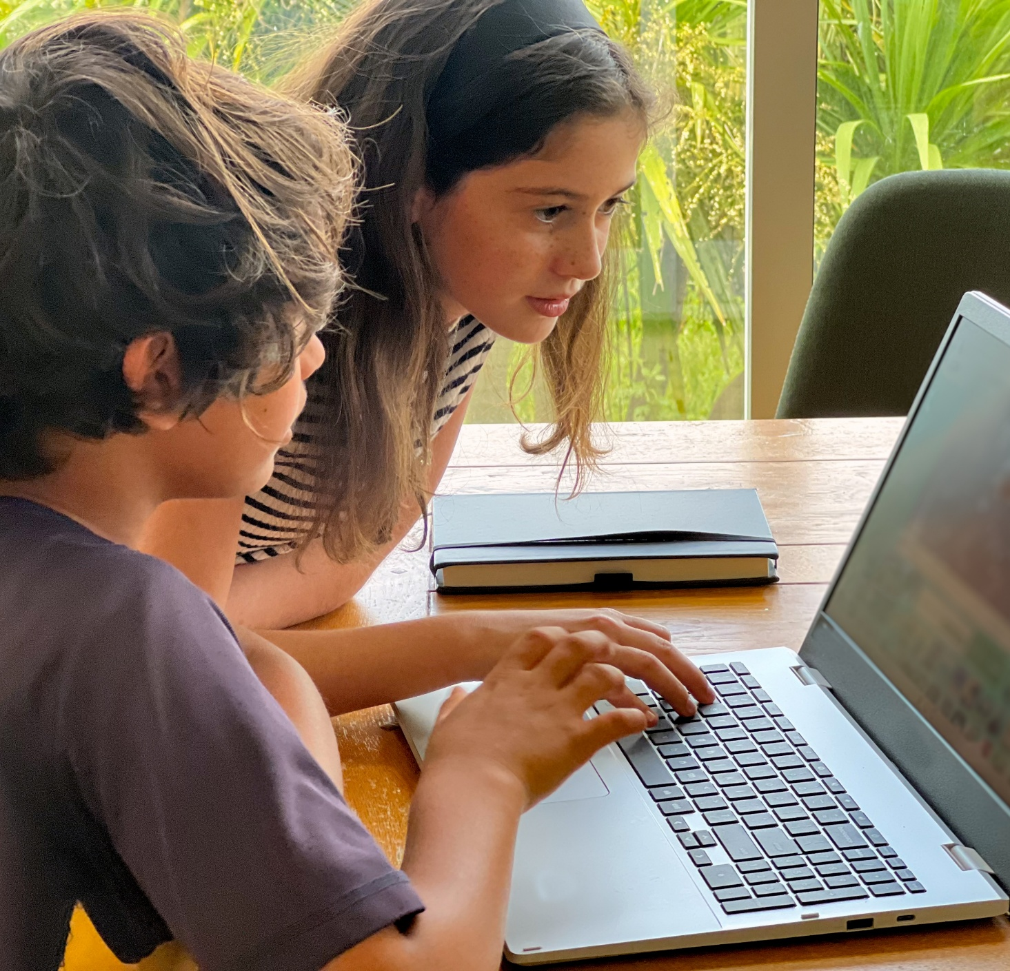
07
Online games

Slide 39
Online games – summary
Platforms
Online games are a major part of children’s media lives, with participation rising sharply from age 9 and peaking among older boys and Māori children.
Nearly four in ten children (39%) play online games daily, with consoles (49%), smartphones (43%), tablets (40%), and computers (37%) all commonly used for online games.
Multi player games like Roblox and Fortnite lead as the most popular games, but children also enjoy world building, creative, adventure, and educational games, with preferences varying by age and gender.
Demographic insights
Younger children favour educational and creative games, while older children gravitate toward multiplayer and action titles.
Boys are more likely to play fighting, racing, and sports games, whereas girls prefer creative and role playing experiences.
Most children prioritise fun over where games are made, however 14% express a preference for New Zealand made or local feeling games – highlighting the dominance of global titles and potentially a limited awareness of local options.

Slide 40
            Playing online games increases from age 9 and peaks with older males. It is also more prevalent among Māori children.
            Playing online games rises from 22% among 5 to 8s to 52% and 55% for 9 to 11s and 12 to 14s, with boys (46%) and Māori children (51%) showing the highest participation.
            Who plays online games?
NZ European
Māori
Pacific peoples
Asian peoples
Verian
            Source: Q14. Thinking about yesterday, which of the following activities did [CHILD] do for 5 minutes or more?
            Base: All caregivers of children aged 4-14-years-old (n=1,024).
            Significantly higher than Total
            Significantly lower than Total
WATA Children’s Media Use 2025

Slide 41
            Children most often play online games on consoles like PS4 and Xbox.
            49% of children aged 5 to 14 play online games on consoles like PS4 and Xbox, ahead of phones (43%), tablets (40%), and computers (37%).
            Devices online games are played on
Verian
            Source: Q73. What devices do you play online games on?
            Base: Children aged 5 to 14 years who play online games n=409
WATA Children’s Media Use 2025

Slide 42
            Multi-player games like Roblox and Fortnite lead, but children’s online game preferences are broad and varied.
            74% of children enjoy multi player games like Roblox and Fortnite, but many also play world building (46%), and creative games (41%).
            Types of online games children like playing
Multi-player games (e.g. Roblox, Fortnite, playing with others online)
World building games (e.g. Minecraft, Terraria)
Creative games (e.g. designing, building, making things)
Fighting / shooting games (e.g. combat, action games)
Adventure games (e.g. exploring new worlds)
Role-playing games (e.g. pretending to be characters, making choices)
Racing games (e.g. car, bike, or obstacle races)
Sports games (e.g. football, basketball, skateboarding)
Educational games (e.g. maths, puzzles, learning games)
Verian
WATA Children’s Media Use 2025
            Source: Q73a. What types of games do you like to play?
            Base: Children aged 5 to 14 years who play online games n=409

Slide 43
Older kids lean into action, younger kids into learning – creative play spans all ages.
Multi player and fighting games rise with age, while educational and role playing games fall. Creative and world building games remain consistently popular across the age groups.
            Types of online games children like playing by age
            Significantly higher than Total
            Significantly lower than Total
            Source: Q73a. What types of games do you like to play?
            Base: Children aged 5 to 14 years who play online games n=409

Slide 44
Both boys and girls enjoy multiplayer games, yet their other preferences contrast.
While both enjoy multiplayer games, boys favor fighting, racing, and sports games, while girls lean toward creative, adventure, and role playing games.
.
            Types of online games children like playing by gender
Boys Girls
            Significantly higher than Total
            Significantly lower than Total
            Source: Q73a. What types of games do you like to play?
            Base: Children aged 5 to 14 years who play online games n=409

Slide 45
            Children mostly just want games to be fun – they are less concerned about where they’re made.
            38% of children say they don’t mind where games are made as long as they’re fun, while only 14% prefer New Zealand made or local feeling games – likely due to limited awareness and the dominance of global titles like Roblox.
            Appeal of games that are made in Aotearoa New Zealand
Verian
            Source: Q73b. Do you like playing games that are made in Aotearoa New Zealand?
            Base: Children aged 5 to 14 years who play online games n=409

Slide 46

08
What influences children’s content choices?

Slide 47
Content choices – summary
Media moments
Children’s content choices are shaped by a mix of personal interests, social influences, and digital discovery tools.
Younger children are guided more by caregivers and family routines, while older children increasingly seek independence, choosing content that reflects their identity, interests, and peer recommendations.
Key occasions for media consumption include after school wind-down, family time, and travel, with older children more likely to use media for relaxation and connection.
Children value media that is fun, allows choice, sparks ideas, and supports learning.
Te reo Māori content is especially appreciated by Māori and Pacific children for its cultural and language benefits.
Emotional drivers are strong, with most children saying media makes them happy, helps them relax, and fosters a sense of belonging.
Discovery
Discovery of new content is highly dynamic: children use a combination of searching, browsing, algorithm driven recommendations, and suggestions from friends, family, and creators.
While 83% rely on people around them for new content, an equal proportion actively find things themselves, highlighting the importance of both social and digital pathways in shaping media experiences.

Slide 48
From playful learning to identity affirmation, children move through distinct stages of engagement.
Playful learning
Emerging interactivity
Identity formation
Identity affirmation
2 TO 5 YEARS
6 TO 8 YEARS
9 TO 11 YEARS
12 TO 14 YEARS

Slide 49
            What occasions drive media consumption for children?
            Media consumption occasions
Age 4 to 8
Age 12 to 14
Age 12 to 14
Older children (especially 12 to 14 years) are more likely to use media for personal reasons – relaxing after school, playing independently, before bed, and while traveling.
Younger children are more likely to use media in contexts where caregivers set the terms – when caregivers are busy, for family time, or as a reward.
Age 4 to 8
Age 4 to 8
Age 12 to 14
Age 4 to 8
            Source: Q17. Thinking about a typical day, when does [CHILD] usually engage with media?
            Base: All caregivers of children aged 4-14-years-old (n=1,024).
Verian
            Significantly higher than Total
            Significantly lower than Total

Slide 50
            Children enjoy content for many reasons.
            Older kids value independence, younger prefer repetition and learning and enjoy hearing te reo Māori, as do Māori and Pacific children.
            What children like about watching, playing or listening to media
It’s fun and keeps me busy
I get to choose what I want to watch, listen to, or play
It gives me cool ideas
I play games or watch people play
I like watching the same thing again and again
It helps me learn something cool - like cooking, sport, or art
I learn new words or facts
It teaches me good things – like being kind, sharing, solving problems
It’s just on in the background
It shows good behaviour - like sharing or solving problems
I hear te reo Māori - and learn, enjoy hearing it
Age 12 to 14
Age 9 to 11
Age 9 to 11
Boys
Māori / Pacific
Age 5 to 8
Age 5 to 8
Age 12 to 14
Age 5 to 8
Age 5 to 8
Māori / Pacific
            Source: Q76. When you watch, play, or listen to things, what do you like about it?
            Base: Children aged 5-14 years (n=1,024).
Verian
            Significantly higher than Total
            Significantly lower than Total

Slide 51
            Consuming media makes children feel happy — older children also use it to relax and connect.
            61% of children say media makes them feel happy or laugh, while older children (9 to 14) are more likely to say it helps them relax and feel connected with friends.
            How children feel when watching, playing or listening to media
Age 5 to 8
Age 9 to 14
Age 12 to 14
Age 5 to 8
Age 12 to 14
            Source: Q77. How does watching, playing, or listening make you feel?
            Base: Children aged 5-14 years (n=1,024).
Verian
            Significantly higher than Total
            Significantly lower than Total

Slide 52
When it comes to discovering their own content, children use a mix of behaviours and tools and they’re all popular – from active self discovery, influence from others, and relying on algorithms.
83%
I find things myself (NET)
83%
People around help me (NET)
72%
The app or site helps (NET)
Higher among 9 to 14’s
Higher among 9 to 14’s
Higher among 12 to 14’s
48% - I go back to my favourites - shows or videos I’ve seen before
40% - I search for it - I know what I want and look it up
38% - I choose things I like - like sport, animals, art, or games
46% - A friend or classmate told me about it
30% - I watch stuff from creators I like
28% - My parent or caregiver suggested it
40% - It popped up because of what I watched before
39% - I found it by scrolling or browsing
35% - I clicked on a picture or title that looked cool
Q81. How do you usually find new things to watch, play, or listen to?
Children aged 5 to 14 years n=1,024
            Significantly higher than Total
            Significantly lower than Total

Slide 53

09
YouTube in detail

Slide 54
YouTube – summary
Access
YouTube plays a central role in children’s media lives, with 69% of children using YouTube or YouTube Kids daily.
Younger children (4 to 8) are more likely to access YouTube through caregiver or whānau accounts and watch on smart TVs, while older children (12 to 14) increasingly use their own accounts and prefer smartphones or computers.
Over half of children (58%) choose their own content on YouTube with little caregiver intervention, a trend that grows with age.
Safety, restrictions, controls
Caregivers actively manage YouTube content for younger children, employing a range of safety tools and parental controls. These include YouTube Kids, supervised accounts with content level settings, restricted mode, approved channels, and manual selection or approval of videos. Watching together is also a common strategy for monitoring viewing.
However, parental oversight drops sharply as children get older: 39% of 12 to14 year olds report no parental controls are used at all.
Children discover content on YouTube through a mix of browsing, searching, algorithm driven recommendations, and influencer channels.
Younger children rely more on scrolling and thumbnails, while older children follow creators and use recommendations.
WATA Children’s Media Use 2025

Slide 55
Setting the scene
            YouTube Kids strongly and successfully ‘competes’ with YouTube for the eyes, ears, and attention of younger children. YouTube rapidly takes over from 9 years on.
Average daily reach of YouTube
54%
27%
YouTube Kids
YouTube
69%
Watch YouTube or YouTube Kids
Verian
            Source: Q14. Thinking about yesterday, which of the following activities did [CHILD] do for 5 minutes or more?
            Base: All caregivers of children aged 4-14-years-old (n=1,024).

Slide 56
Nearly six in ten (57%) children aged 4 to 14 years access YouTube through their caregiver or whānau accounts.
            YouTube access becomes more independent from age 9, with 12 to 14 year olds increasingly using their own account or no account at all.
Child is accessing YouTube through …
Caregivers account
A caregivers account
Child has their own account
No account
Child’s has their own account
A whānau account
No account
Not sure
Note: there is no difference by age group for children using a whānau account
Verian
            Source: Q27 When [CHILD] watches YouTube - whether you choose the videos for them or they browse themselves - how do they usually access it? Base: Caregivers of children aged 4 to 14 who use YouTube / YouTube Kids n=715

Slide 57
Just over half (58%) of children are choosing the content they consume on YouTube with little or no caregiver intervention.
Who controls what content children are accessing on YouTube by age
Who controls what content is watched?
Caregiver gives a bit of guidance
Caregiver chooses most
Child mostly chooses, (some boundaries)
Child mostly chooses, (some boundaries)
Caregiver gives a bit of guidance
Child chooses / no caregiver controls
Caregiver chooses most
Child chooses / no caregiver controls
Other
This is more likely to be the case for 9 to 14 year olds.
Verian
            Source: Q28 When it comes to the content [CHILD] watches, plays, or listens to on YouTube, how much control or influence do you feel you have over what they engage with?
            Base: Caregivers of children aged 4 to 14 who use YouTube / YouTube Kids n=715

Slide 58
68% of caregivers use safety tools or tech settings to manage content on YouTube for their child.
What parental controls or safety settings are caregivers using to manage what their child can watch on YouTube?
Age 5 to 8 (52%)
Age 12 to 14 (21%)
Age 12 to 14 (9%)
Age 12 to 14 (17%)
Parental control drops with age. Caregivers of 4 to 8s actively manage content, while 12 to 14s are far more likely to use YouTube without supervision.
Age 5 to 8 (21%)
Age 9 to 11 (5%)
Age 12 to 14 (5%)
Age 5 to 8 (10%)
Age 12 to 14 (39%)
            Significantly higher than Total
            Significantly lower than Total
Verian
            Source: Q29 Do you use any parental controls or safety settings to manage what [CHILD] can watch on YouTube?
            Base: Caregivers of children aged 4 to 14 who use YouTube / YouTube Kids and have some control or influence over the content their child engages with at Q28 n=696

Slide 59
Younger children watch YouTube on TV – older children prefer phones and computers
Devices children use to watch YouTube
Age 5 to 8 (63%)
Age 12 to 14 (45%)
63% of 5 to 8s use smart TVs to watch YouTube, while 56% of 12 to 14s use smartphones and 38% use laptops or desktops.
Age 12 to 14 (56%)
Age 5 to 8 (13%)
Age 12 to 14 (38%)
            Significantly higher than Total
            Significantly lower than Total
Verian
            Source: Q32 When [CHILD] watches YouTube, what device/s do they usually use?
            Base: Caregivers of children aged 4 to 14 who use YouTube n=715

Slide 60
Children use a combination of methods to find content on YouTube.
Younger children tend to scroll and click while older children follow influencers and are more likely to rely on recommendations.
How children find content to watch on YouTube
Age 5 to 8 (37%)
Age 5 to 8 (51%)
Age 5 to 8 (35%)
Age 5 to 8 (23%)
Age 12 to 14 (52%)
Age 5 to 8 (20%)
Age 12 to 14 (37%)
            Significantly higher than Total
            Significantly lower than Total
Verian
            Source: Q83 When you use YouTube or YouTube Kids, how do you usually find videos to watch?
            Base: Children aged 5 to 14 who use YouTube and mostly choose what they watch n=613

Slide 61

10
Engaging with New Zealand and te reo Māori content

Slide 62
New Zealand and te reo Māori content – summary
Engagement
New Zealand children regularly engage with local or te reo Māori content, though participation declines with age.
Of those who do engage, 44% do so weekly, with slightly higher engagement for New Zealand made content compared to te reo Māori content.
Caregivers value New Zealand content for its relatable stories, educational benefits, cultural connection, and safety.
Te reo Māori content is especially appreciated for supporting language development, fostering pride in identity, and helping all children learn about and respect Māori culture.
Caregivers expect to find New Zealand and te reo Māori content primarily on New Zealand free to air TV channels and BVOD (on demand) platforms.
Older children tend to look to YouTube, although TVNZ channels and Whakaata Māori are also seen as key destinations for local stories and language content.
Barriers
Barriers to engagement include difficulty finding local or te reo Māori content, a perceived limited availability on preferred platforms, and perceptions that overseas options are more appealing or polished. Perhaps not surprisingly, these are cited more often by those who have not recently watched local content.
These findings highlight the need to ensure New Zealand and te reo Māori content is highly visible, easily accessible, and attractive to diverse audiences – across all the platforms where caregivers and children expect to find it.
WATA Children’s Media Use 2025

Slide 63
How many children are engaging with New Zealand and te reo Māori content, and how often?
Engagement with New Zealand content by age
50%
of New Zealand children engage with local or te reo Māori content
40%
do not engage at all
New Zealand or te reo Māori content
Lower engagement than 4 to 8 years
Engagement declines with age. Older children (12 to 14) still participate, but less than younger children (4 to 8).
            Significantly higher
            Significantly lower
Verian
            Source: Q33 Which of the following types of content does [CHILD] currently watch, listen to, or play?
            Base: All caregivers with children aged 4 to 14 years old, n=1,024

Slide 64
Children regularly engage with New Zealand and te reo Māori content, with slightly higher engagement for New Zealand content.
Frequency of viewing New Zealand content
New Zealand content
Te reo Māori content
Regularly
(at least once a week)
2020:
59%
Of those engaging with New Zealand content, 44% do so weekly (down from 59% in 2020*).
Engagement with te reo Māori content shows similar patterns, though slightly lower weekly engagement.
Occasionally
(once or twice a month)
Rarely
(less than once a month)
Never
Not sure
            Source: Q35. How often does [CHILD] watch or engage with New Zealand made content?
            Base: All caregivers with children aged 4 to 14 years engage with NZ or te reo Māori content, n=510
            *Note 2020 asked for watching NZ shows and programmes only. 2025 asked of broader NZ content engagement: watch, listen, play.
Verian
            Significantly higher than 2020
            Significantly lower than 2020

Slide 65
Caregivers expect to find New Zealand and te reo Māori content for their children on New Zealand free to air and BVOD platforms.
            Top five platforms caregivers expect to find New Zealand made or te reo Māori content
Whakaata Māori
TVNZ1
TVNZ+
TVNZ2
Māori+
Source: Q43 On which devices or platforms would you expect to find (or like to see more) New Zealand made or te reo Māori content for [CHILD]?
Base: Caregivers whose children engage with local content, n=510

Slide 66
Children would expect to find New Zealand and te reo Māori content on BVOD and YouTube.
            Top 5 platforms children expect to find New Zealand made or te reo Māori content
BVOD
YouTube/ YouTube Kids
NZ free to air broadcast TV
Social Media
Radio – broadcast or online
YouTube or YouTube Kids?
5 to 8 year olds are significantly more likely to head to YouTube Kids than 9 to 14 year olds (they’re heading to YouTube for local content)
Among BVOD and New Zealand free to air providers, Māori+ leads (26%), followed by TVNZ+ (21%), with Whakaata Māori’s free to air channel close behind (20%).
Verian
            Source: Q91 Imagine you want to watch something made in New Zealand or in te reo Māori. Where would you look first?
            Base: Children aged 5 to 14 years who are engaging with New Zealand content, n=510

Slide 67
What are the benefits of children consuming New Zealand content?
            Benefits of watching New Zealand made content
From a caregiver perspective, the benefits are rich and diverse, and particularly for helping instil a sense of connection and identity, educational benefits, and providing trusted and safe sources of content.
Verian
            Source: Q36 What motivates [CHILD] to watch New Zealand made content – or you to choose it for them?
            Base: Caregivers whose children engage with New Zealand content, n=486

Slide 68
What are the barriers?
            Barriers to watching more New Zealand made content
Discoverability and the belief that local content just doesn’t appeal or entertain as much as other content remain key challenges to New Zealand content consumption.
Those who have not watched New Zealand content recently are more likely to rate the following barriers:
- Not aware, hard to find
- Doesn’t appeal
- Prefer overseas content
- Doesn’t meet entertainment needs
Verian
            Source: Q37 What, if anything, limits [CHILD] from watching more New Zealand made content?
            Base: Caregivers whose children engage with New Zealand content, n=486

Slide 69
What are the benefits of children consuming te reo Māori content?
            Top 10 benefits of watching te reo Māori content
From a caregiver perspective, the benefits of their child engaging with te reo Māori content are plentiful – ticking not only the entertainment and educational boxes but also many cultural, connection, language, and identity values.
Verian
            Source: Q41 What motivates [CHILD] to watch te reo Māori content – or you to choose it for them?
            Base: Caregivers whose children engage with te reo Māori content n=211

Slide 70
For whānau Māori, the benefits of watching te reo Māori content are strongly linked to belonging, identity, and culture.
            Top 10 benefits – including Māori perspective
Total
Māori
43%
43%
57%
44%
36%
36%
35%
29%
43%
47%
Connection to te ao Māori is the top benefit for Māori
57%
Of Māori say that connection to te ao Māori is what motivates their child to watch te reo Māori content – or them to choose it for them.
            Significantly higher
            Significantly lower
Verian
            Source: Q41 What motivates [CHILD] to watch te reo Māori content – or you to choose it for them?
            Base: Caregivers whose children engage with te reo Māori content n=211

Slide 71
What are the barriers?
            Barriers to watching more te reo Māori content
Discoverability, availability, not enough variety, and language ‘barriers’ are the biggest challenges for te reo Māori content.
Māori 35%
Those who have not watched te reo Māori content recently are more likely to rate the following barriers:
Don’t speak or understand te reo Māori
Not aware, hard to find
Doesn’t appeal
Māori 0%
            Significantly higher
            Significantly lower
Verian
            Source: Q42 What, if anything, limits [CHILD] from watching more te reo Māori content?
            Base: Caregivers whose children engage with te reo Māori content n=211

Slide 72
What benefits do children get out of watching te reo Māori content?
Children gain a wide range of benefits from watching te reo Māori content, especially Māori children. Across all children, watching Māori content supports learning, cultural connection, and identity. This is particularly strong for Māori children, who are most likely to say it’s fun and interesting and show higher agreement across benefits like pride, belonging, and connection to culture and language.
            Children’s views on why they like te reo Māori content
            Source: Q89. What do you like about te reo Māori shows, movies, or games?
            Base: Children 5 to 14 years who watch/play something that uses te reo Māori (n=252)
            Significantly higher than average
            Significantly lower than average

Slide 73
Appendix

Slide 74
Smart tech ownership is relatively high for all incomes, traditional device ownership is low and consistent.
Nearly all households have smartphones, smart TVs, and computers, but lower income households are less likely to own computers, streaming devices, and smart speakers. Traditional device ownership is low and consistent across all demographics.
 |  | Ethnicity |  |  |  | Region |  |  |  |  | Household Income
 | Total | NZ European | Māori | Pacific Peoples | Asian Peoples | Auckland | Welling ton | Other North Island | Canter bury | Other South Island | Up to $50k | $51k - $70k | $71k -$100k | $101k - $150k | $150k +
Smartphone | 95% | 95% | 92% | 94% | 96% | 96% | 94% | 95% | 97% | 91% | 91% | 94% | 97% | 95% | 96%
Television | 94% | 94% | 94% | 96% | 94% | 93% | 95% | 94% | 95% | 99% | 91% | 96% | 95% | 95% | 95%
Smart TV | 82% | 81% | 81% | 73% | 85% | 87% | 81% | 75% | 85% | 82% | 62% | 82% | 70% | 86% | 89%
Computer / laptop for personal use | 83% | 83% | 79% | 84% | 90% | 84% | 85% | 79% | 90% | 85% | 70% | 81% | 88% | 84% | 87%
Tablet (e.g. iPad) | 71% | 71% | 66% | 73% | 75% | 75% | 77% | 68% | 71% | 67% | 64% | 66% | 67% | 70% | 78%
Games console (e.g. Xbox, PlayStation) | 63% | 66% | 72% | 70% | 56% | 59% | 63% | 65% | 69% | 63% | 66% | 62% | 61% | 65% | 61%
Streaming device (e.g. Apple TV, Chromecast) | 56% | 56% | 62% | 53% | 49% | 59% | 58% | 56% | 45% | 54% | 46% | 41% | 56% | 57% | 61%
Radio | 40% | 42% | 36% | 38% | 34% | 35% | 44% | 39% | 45% | 54% | 34% | 39% | 46% | 45% | 39%
Smart speaker e.g. Alexa, Google Home | 34% | 36% | 33% | 27% | 38% | 36% | 28% | 35% | 36% | 28% | 22% | 34% | 25% | 31% | 43%
DVD or Blu-ray player | 32% | 36% | 31% | 37% | 23% | 28% | 34% | 36% | 32% | 33% | 34% | 33% | 34% | 34% | 30%
SKY TV box | 20% | 20% | 23% | 28% | 12% | 22% | 19% | 18% | 16% | 25% | 21% | 20% | 18% | 19% | 21%
PVR (e.g. MySKY, MyFreeview) | 16% | 17% | 21% | 18% | 12% | 12% | 17% | 19% | 11% | 21% | 15% | 14% | 17% | 19% | 14%
Ethnicity
Region
Household income
            Devices available in your home
            Source: Q11. Which of these devices do you have in your home?
            Base: All caregivers of children aged 4-14-years-old (n=1,024).
            Significantly higher than Total
            Significantly lower than Total

Slide 75
Girls balance streaming and YouTube use, while boys gravitate towards YouTube, Sky TV, and online games.
Girls engage equally with overseas streaming services (50%) and YouTube (49%), whereas boys show a stronger preference for YouTube (60%), online games (46%), and Sky TV (15%)
 |  | Age |  |  | Gender
 | Total | 4 to 8 years | 9 to 11 years | 12 to 14 years | Male | Female
Watch TV on an overseas service | 46% | 51% | 42% | 41% | 42% | 50%
Watch live or on demand (BVOD) free to air TV | 37% | 36% | 35% | 38% | 36% | 37%
Watch live or recorded TV through Sky or MySky | 11% | 10% | 11% | 13% | 15% | 7%
Watch live or recorded TV through Freeview | 8% | 6% | 11% | 8% | 9% | 7%
Watch a TV show on Neon | 4% | 5% | 3% | 3% | 4% | 3%
YouTube | 54% | 39% | 63% | 70% | 60% | 49%
YouTube Kids | 27% | 42% | 21% | 9% | 29% | 25%
Played online games | 39% | 20% | 52% | 55% | 46% | 32%
Listened to music online | 26% | 22% | 24% | 36% | 25% | 28%
Listened to a NZ radio station-broadcast/online | 13% | 14% | 14% | 12% | 15% | 12%
Listened to music including CDs or iPod | 6% | 4% | 5% | 9% | 6% | 5%
Listened to a podcast or audiobook | 5% | 3% | 5% | 6% | 4% | 6%
Listened to an overseas radio station online | 1% | 1% | 2% | 1% | 2% | 1%
Watched a video on social media | 24% | 11% | 21% | 45% | 23% | 24%
            Types of media children consume each day
Ethnicity
            Significantly higher than Total
            Significantly lower than Total
            Source: Q14. Thinking about yesterday, which of the following activities did [CHILD] do for 5 minutes or more?
            Base: All caregivers of children aged 4-14-years-old (n=1,024).
            .

Slide 76
12 to 14 year olds exhibit significantly higher usage across most social media platforms.
Daily reach is significantly higher among 12 to14s across most platforms, including TikTok (31%), Snapchat (30%), and Instagram (22%).
            Daily reach of social media apps or sites
 |  | Age |  |  | Gender
 | Total | 5 to 8 years | 9 to 11 years | 12 to 14 years | Male | Female
TikTok | 13% | 2% | 14% | 31% | 13% | 14%
Snapchat | 11% | 1% | 6% | 30% | 9% | 12%
Instagram | 8% | 2% | 3% | 22% | 9% | 7%
Facebook | 7% | 3% | 7% | 15% | 6% | 8%
WhatsApp | 4% | 2% | 3% | 9% | 3% | 5%
Messenger Kids | 4% | 1% | 7% | 6% | 1% | 6%
WhatsApp | 4% | 1% | 2% | 10% | 4% | 3%
Discord | 2% | 0% | 1% | 6% | 3% | 1%
Twitch | 1% | 0% | 0% | 4% | 1% | 1%
Twitter / X | 1% | 0% | 1% | 1% | 1% | 1%
Source: Q72. Which of these social media apps or sites did you use yesterday?
Q74 Which of these music apps or sites did you use yesterday?
Base All children 5 to 14 years n=1,024
            Significantly higher than Total
            Significantly lower than Total

Slide 77
Older children drive audio streaming, showing stronger engagement than younger cohorts.
Spotify reaches 40% of 12 to 14 year olds daily, with YouTube for music at 14% – both significantly higher than average and younger age groups.
            Daily reach of music apps or sites
 |  | Age |  |  | Gender
 | Total | 5 to 8 years | 9 to 11 years | 12 to 14 years | Male | Female
Spotify | 25% | 17% | 27% | 40% | 21% | 29%
YouTube (for music) | 9% | 7% | 10% | 14% | 8% | 11%
Apple Music | 2% | 2% | 2% | 3% | 3% | 2%
Audiobook | 1% | 1% | 2% | 1% | 2% | 1%
iHeartRadio | 1% | 1% | 1% | 2% | 1% | 1%
SoundCloud | 1% | 1% | 0% | 2% | 1% | 0%
Source: Q74. Which of these music apps or sites did you use yesterday?
Q74 Which of these music apps or sites did you use yesterday?
Base All children 5 to 14 years n=1,024
            Significantly higher than Total
            Significantly lower than Total

Slide 78
Game preferences vary by age and gender multi-player games lead across the board. Younger children play educational, creative and world building games; games like Roblox and Fortnite are the go to for older children, with boys favouring fighting, racing and sports, and girls leaning toward creative and role playing games.
            Types of online games children like playing
 |  | Age |  |  | Gender
 | Total | 5 to 8 years | 9 to 11 years | 12 to 14 years | Male | Female
Multi-player games (e.g. Roblox, Fortnite, playing with others online) | 74% | 58% | 79% | 78% | 71% | 78%
World building games (e.g. Minecraft, Terraria) | 46% | 53% | 43% | 45% | 52% | 37%
Creative games (e.g. designing, building, making things) | 41% | 44% | 43% | 39% | 37% | 47%
Fighting / shooting games (e.g. combat, action games) | 35% | 31% | 26% | 44% | 50% | 13%
Adventure games (e.g. exploring new worlds) | 33% | 36% | 33% | 31% | 33% | 32%
Role-playing games (e.g. pretending to be characters, making choices) | 29% | 36% | 34% | 22% | 26% | 34%
Racing games (e.g. car, bike, or obstacle races) | 24% | 33% | 16% | 25% | 31% | 13%
Sports games (e.g. football, basketball, skateboarding) | 21% | 23% | 15% | 25% | 28% | 11%
Educational games (e.g. maths, puzzles, learning games) | 21% | 37% | 15% | 17% | 20% | 22%
            Significantly higher than Total
            Significantly lower than Total
            Source: Q73a. What types of games do you like to play?
            Base: Children aged 5 to 14 years who play online games n=409

